Slide 1
Lead Scoring Case Study -Logistics Regression
By
Jeetendra H. Sarpe

Slide 2
Problem Statement:
An education company named X Education sells online courses to industry professionals.
The company markets its courses on several websites and search engines like Google. Once these people land on the website, they might browse the courses or fill up a form for the course or watch some videos. When these people fill up a form providing their email address or phone number, they are classified to be a lead.
Once these leads are acquired, employees from the sales team start making calls, writing emails, etc. Through this process, some of the leads get converted while most do not. The typical lead conversion rate at X education is around 30%.
To make this process more efficient, the company wishes to identify the most potential leads, also known as ‘Hot Leads’. If they successfully identify this set of leads, the lead conversion rate should go up as the sales team will now be focusing more on communicating with the potential leads rather than making calls to everyone.
Business Objective
The company wishes to identify the most potential leads, also known as ‘Hot Leads’.
The company requires a model wherein a lead score will be assigned to each of the leads such that the customers with higher lead score have a higher conversion chance and the customers with lower lead score have a lower conversion chance.
The CEO, in particular, has given a ballpark of the target lead conversion rate to be around 80%.

Slide 3
Analysis Approach
Data Understanding, Cleaning and Manipulation:
Reading Data, checking dimensions and data types of variables.
Checking Duplicates entries, missing values and imputing missing values.
Cleaning data frame, Checking entries in each variable and manipulating.
Handling Outliers.
Exploratory Data Analysis:
Univariate Analysis : Description and Visualization.
Bi-Variate Analysis: : Comparing Target Variable with other, Data Visualization.
Dummy Variables, Train-Test split, Scaling features.
Building Logistics Regression Model/ Training the Model:
Basic Model building using all features.
Model Building using Recursive Feature Elimination.
Dropping variables on basis of p-value and Variance Influence Factor, and checking Metrics and Lead Score for corresponding Models.
Making Predictions on Test data set and Model Validation.
Model Presentation.
Conclusion and Recommendations.

Slide 4
Data Understanding, Cleaning
Data contains 9240 entries with total 37 variables, with ‘Converted’ as our Target variable.
Dropping ProspectID and Lead Number, some variables contains single category hence dropping them.
Dropping variables with missing values more than 40%, for rest imputing missing values. Also there were some entries with ‘Select’ as a category handling them either by imputing or dropping those variables.
Clubbing some categories with similar meanings and some for ease of Analysis.
Handling the Outliers by Capping them.
Dimensions of the data set after the above operations is 5799 entries and 20 variables.

Slide 5
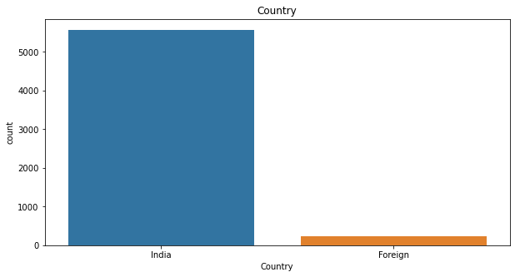
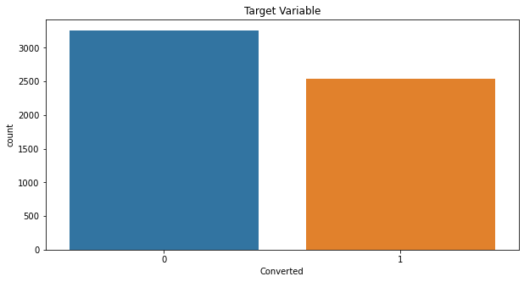
Exploratory Data Analysis:
Univariate Analysis:
Maximum Leads are found to be of Indian Nationality.
Lead Conversion rate for the current data set is 43.82%

Slide 6
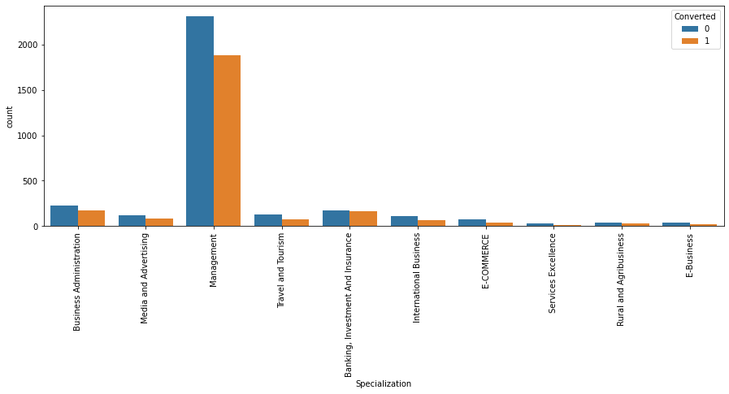
Bi-Variate Analysis:
Leads are interested in Management related course.

Slide 7
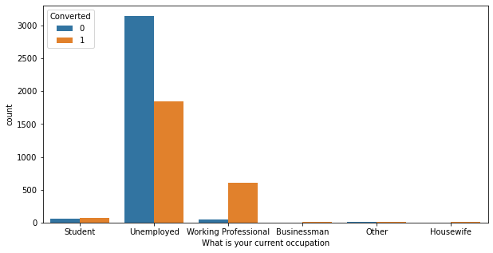
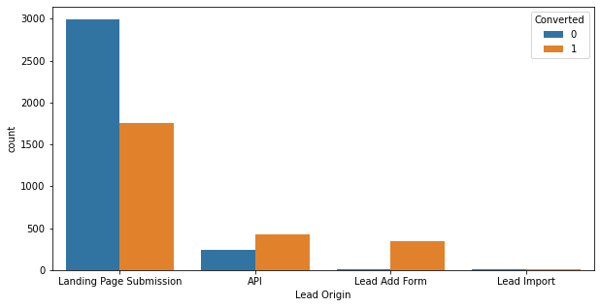
Working Professional have better chance at converting to a Lead
Leads origin from Lead add form beats other category and have better conversion rate.

Slide 8
Dummy Variables, Train-Test Split and Scaling
Dummies are created for all Categorical Variables except Converted.
Size of the Data Frame after creating dummies (5788, 50).
Data set is split into Train and Test sets in 70:30 ratio resp.
Size of Train data set (4051, 49) and Test set (1737, 49).
Train and Test sets have both Independent and Dependent Variables.
Numerical Variables are Normalized.

Slide 9
Model Building
First a Model is built by including each variable.
To have a better model, the next Logistics Regression models are built with the assistance of Recursive Feature elimination and in RFE we’re taking 20 features as output. Reason being some feature are sure to be eliminated, and for a final model a maximum of 14 to 15 features are recommended.
Along with eliminations on basis of p-value and RFE, we also check the metrics such as Accuracy of the Model to keep track of our objective.
Once the p-value and RFE score are within the permissible range, we check the metrics such as Sensitivity and Specificity.
With a current cut-off of 0.5, the Sensitivity of the model is 72%,but we need to find a optimal threshold so that the Sensitivity of the model is increased but also keep the other metrics in range.
The Current Accuracy of our model is around 79%.

Slide 10
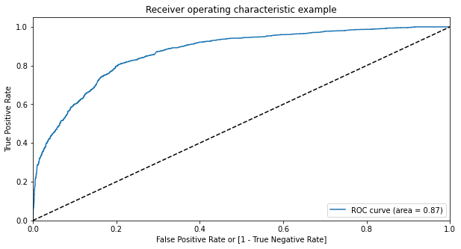
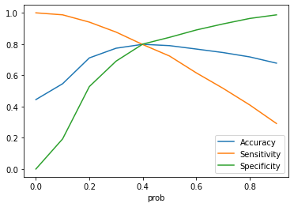
ROC-Curve and Optimal Cut-off
ROC-curve shows the performance of a classification model at all classification thresholds.
After plotting metrics for all cut-off(0 to 0.9) it is found 0.4 as optimal cut-off as these metrics shows stable relation at this cut-off.

Slide 11
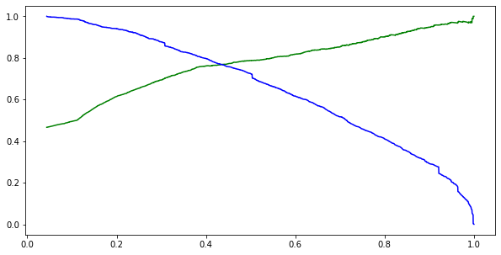
Precision Recall Trade-off
Precision: Probability that a predicted 'Yes' is actually a 'Yes’.
Recall: Probability that an actual 'Yes' case is predicted correctly. 'Recall' is exactly the same as sensitivity.
Precision Recall curve gave a threshold of nearly 0.4, for which we made prediction.

Slide 12
Making Predictions
After Training the model using Train data set, we made predictions on Test data.
The Accuracy of model is 81% and the Sensitivity of this model is 80%
Other metrics are as : Specificity 74% , Precision 76%.
A separate data set is created which is a result of the Prediction on Test data set, a column namely Lead score is added in this data frame which represents how well a lead is likely to get converted.
From this data frame using a reference value of Lead Score we can find the Hot Leads.
Also this new data set suggest a better conversion rate of around 71%.

Slide 13
Conclusion and Recommendations
Top three features that influence the Target variable:
Total Time Spent on Website
Lead Origin_Lead Add Form and
What is your current occupation_Working Professional.
A datum Lead score of 33.0 is found above which there are higher chances of a Lead getting Converted.
The model achieved a Recall Score of 80%, and target of 80% was set. We cay the model is better in predicting.
Other features that influence the Target variable:
Lead Source_Referral Sites.
Do Not Email_Yes
The X education may Target Working professional, vistors who spend more time on site. Students may also be a choice for Target.

